Slide 1
Year 5 Trip to London
Monday 9th – Tuesday 10th June 2025

Slide 2
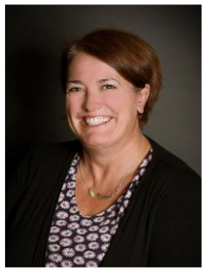
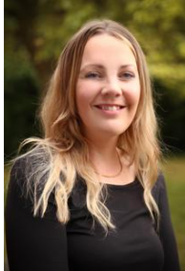
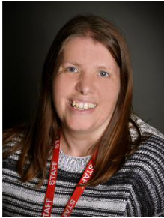
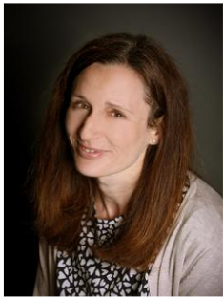
Staff leading our trip
Mrs Hawes Mrs Evans Mrs Watts Miss Shedlow

Slide 3
Tour basics
We’re on our way!
What will we see & do?
About our travel company

Slide 4
Tour basics
Monday 9th June
We will depart from school by coach at 7.30am on Monday 9th June and will arrive in London at approximately 12:30pm.
Please drop your child off at 7:00am at school in order to load luggage onto the coach. At this point, please hand any medical supplies to Mrs Watts. This includes travel sickness aids and hayfever medication.
Children will need to take a packed lunch for the journey (in a small ruscksack) and a bottle of water (no fizzy drinks) Suitable stops will be made en route as necessary. Suitable snacks should also be in the small bag.
Children can bring activities to do on the coach such as colouring, card games and books. Please only provide these things if your child can confidently travel whilst doing them – ie no travel sickness.
.

Slide 5
Tour basics
Returning home on Tuesday 10th June
We will leave London at 3:00pm on Tuesday 10th June and arrive home at approximately 8pm. Please collect your child from the school car park. We will send updates if there are any major changes to timings.
We will stop off for tea at a service station and likely go to Mcdonalds. Children must ensure they have enough money to pay for food here. Whilst supervised, they will order and pay for their own meal. If your child has their own bank card such as Go Henry, that would be extremely useful as this would help them pay at the machines and skip physical queues.

Slide 6

Tour basics
Our accommodation
We will stay at YHA London St. Pauls for 1 night.
This accommodation is on a B&B board basis.
Multi-bedded rooms with shared shower and toilet facilities near to the rooms.
Towels and soap are not provided so please pack these.

Slide 7
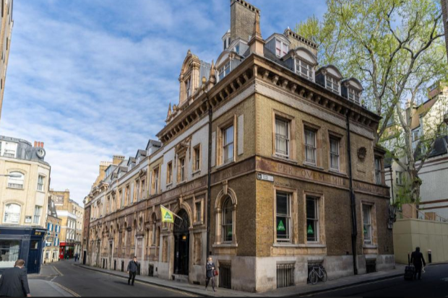
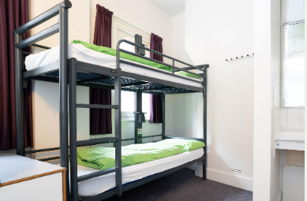
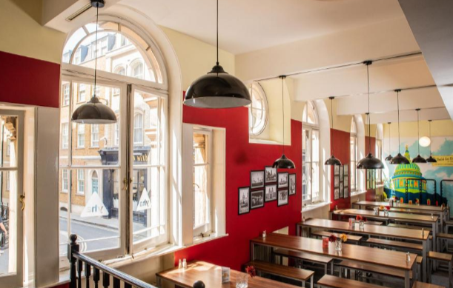

Slide 8
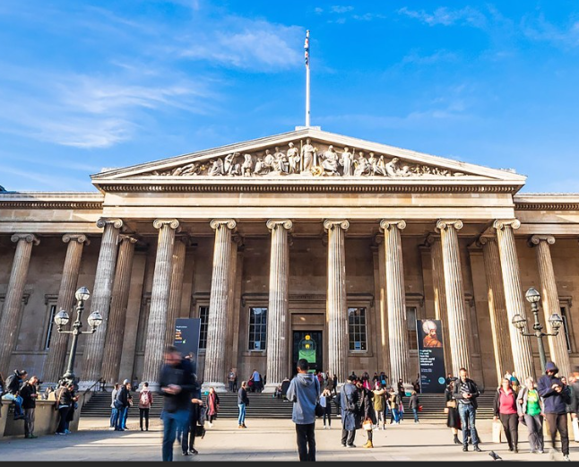
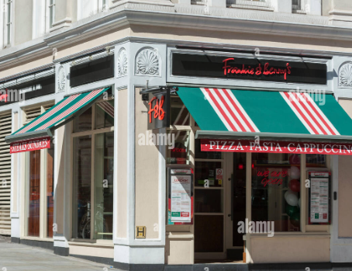
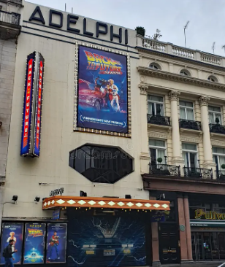
What will we see & do?
Monday
The British Museum
Frankie & Benny’s- evening meal
Back to the Future - the Musical
Adelphi Theatre
Expected start time 7.30pm

Slide 9
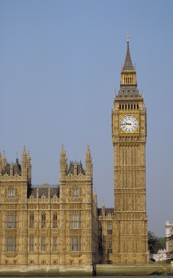
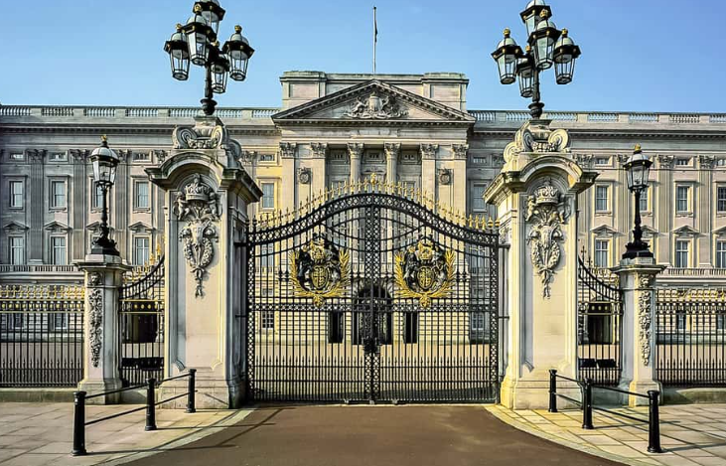
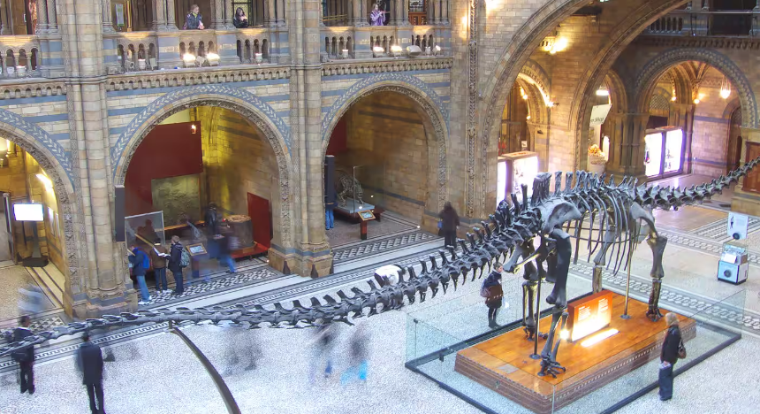
What will we see & do?
Tuesday
Houses of Parliament - Making Law Tour and Workshop
Parliament is a working building and access to different parts of the
Palace may vary. It will likely include:
The House of Commons of Lords chambers
A visit to the public gallery to see MPs working
Westminster Hall, the last remaining part of the original Palace.
Sightseeing by foot – Buckingham Palace, Downing Street
National History Museum

Slide 10
Meal arrangements
Monday 9th June:
Lunch
Children are to bring a packed lunch with them (in a small rucksack) to be eaten when we arrive in London.
Tea
Frankie & Benny’s
Tuesday 10th June:
Breakfast
Continental breakfast buffet at the hostel
Lunch
Packed lunches will be provided by the hostel
Dinner
Service stop en-route home.

Slide 11

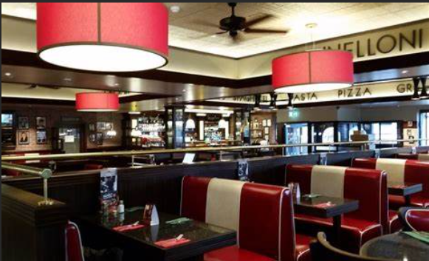
A delicious meal out…………..
Tour basics
We have already chosen our meals and pre-ordered so it will be ready when we get there.

Slide 12
Travel tips
Travel tips – money
We recommend that students take no more than £20 with them on the visit (this includes money to buy dinner on way home). They will be responsible for this and keep this safely in a purse or wallet throughout the trip.

Slide 13
Suggested kit list
Sun cream
Hat
Toiletries
Towel
Trainers (comfortable shoes)
Comfortable clothing to travel there and back
Small rucksack
No more than £20 spending money
Pyjamas
Underwear and socks
Disposable camera (optional)
Non-electronic game for the coach (optional)
Please don’t pack any sweets/snacks etc in your child’s suitcase/bag. We will take additional snacks for the children in general.

Slide 14
Travel tips – packing
As the journey to London is long, we would recommend that children travel in and pack comfortable clothing (not school uniform) for the return journey home.
Children may (if we have time) have a quick change of clothes/ freshen up before we go to Frankie & Benny’s
Please keep an eye on the weather forecast nearer to the time and ensure children have appropriate clothing for the weather. Including sun cream if necessary.
As we will be on our feet throughout the two days – sensible, comfortable shoes are a must!!!

Slide 15

About our travel company
Independent, family-run business that’s dedicated to creating tailor-made international tours for groups.
Operating since 1965
Specialising in Educational Trips, Ski Trips and Sports Tours for schools
Over 23,000 passengers around the world each year.
24-hour on tour emergency contact
ABTA bonded, ATOL licensed and full travel insurance

Slide 16
Safety
Travel
Delta Coaches Ltd
49-seater executive coach (equipped with air-conditioning, seat belts, toilet, DVD)
Clothing
Children will wear high-vis jackets at all times when out and about.
They will wear an identity lanyard with the school name and contact numbers of accompanying staff
Youth Hostel
Staff will hold swipe cards for all the rooms. Doors will automatically lock so that children can get out but not back in unless they have swipe card.
Staff rooms are close by and will have signs on.

Slide 17
Don’t forget…
Drop your child off at school at 7:00am on Monday 9th June.
Collect your child from school at 8:00pm on Tuesday 10th June.
If you have any questions or emergencies whilst your child is away, please contact the school office. Children are not allowed to bring phones.
We’re on our way!

Slide 18
Any questions?

